Slide 1



Engineering Electromagnetics 工程电磁场
Youwei Jia 嘉有为

Slide 2

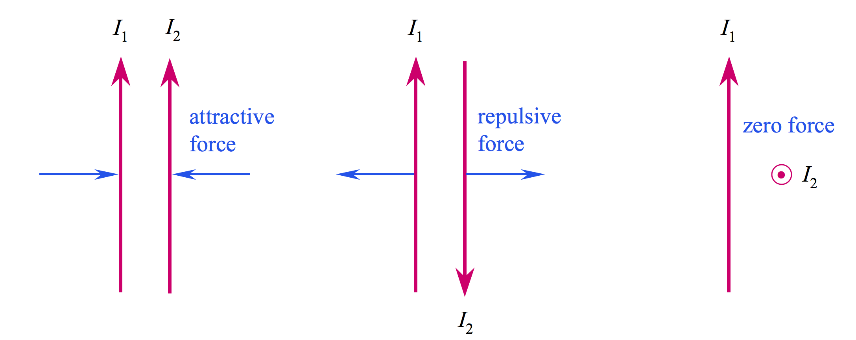
11: The Steady Magnetic Field
Motivating the Magnetic Field Concept: Forces Between Currents
Magnetic forces arise whenever we have charges in motion 运动的电荷!
The source of the steady magnetic field may be a permanent magnet 永磁体, an electric field changing linearly with time随时间线性变化的电场, or a direct current直流电流. We will largely ignore the permanent magnet and save the time-varying electric field for a later discussion. Our present study will concern the magnetic field produced by a differential dc element in free space.
Q: What is the source of electrostatic field?
1

Slide 3
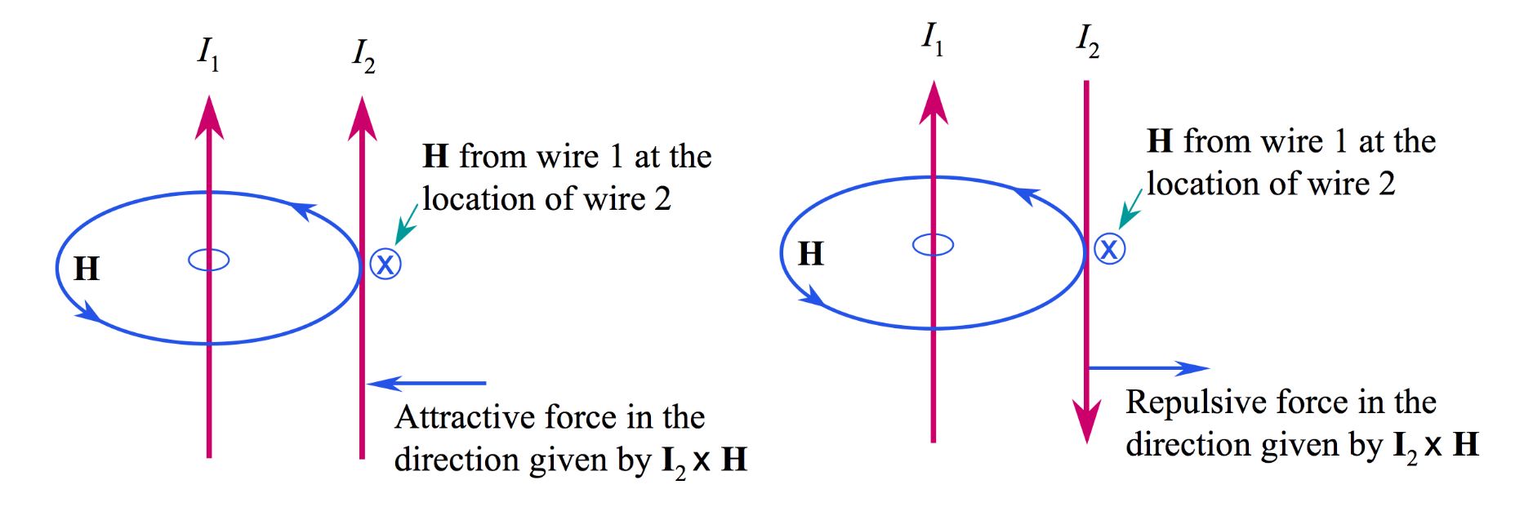
11: The Steady Magnetic Field
Motivating the Magnetic Field Concept: Forces Between Currents
The magnetic field intensity, H, circulates around its source, I₁, in a direction most easily determined by the right-hand rule: Right thumb in the direction of the current, fingers curl in the direction of H.
2

Slide 4
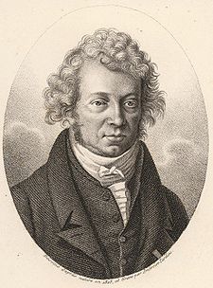
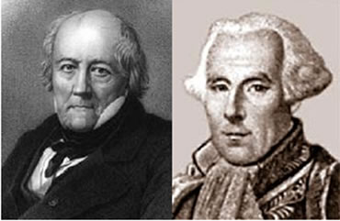
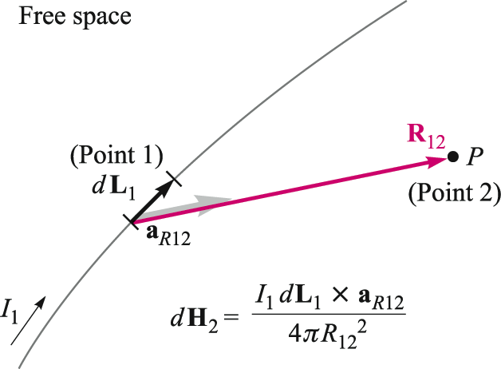
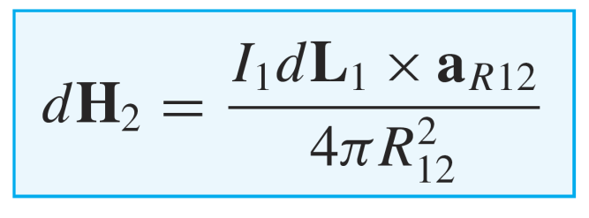
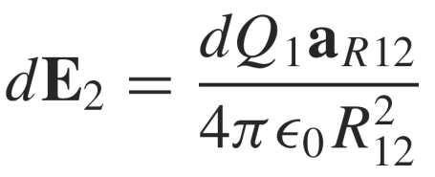
11: The Steady Magnetic Field
Biot-Savart Law
The Biot-Savart Law specifies the magnetic field intensity, H, arising from a “point source” current element of differential length dL.
A. M. Ampère
(1775-1836)
J. B. Biot
(1774-1862)
F. Savart
(1791-1841)
The units of H are [A/m]
Note the similarity to Coulomb’s Law, in which
a point charge of magnitude dQ₁ at Point 1 would
generate electric field at Point 2 given by:
Note in particular the inverse-square
distance dependence, and the fact that
the cross product will yield a field vector
that points into the page. This is a formal
statement of the right-hand rule.
3

Slide 5
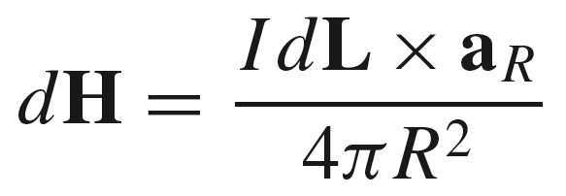
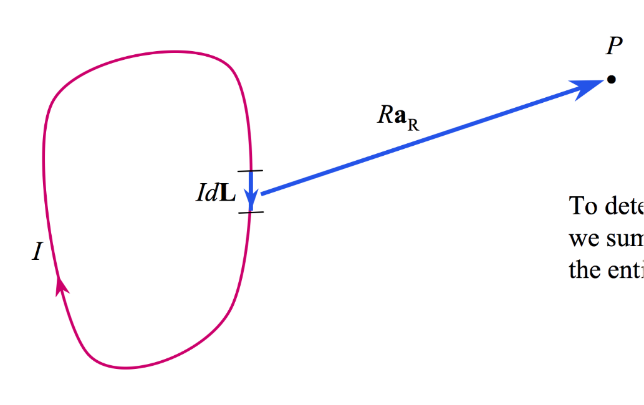
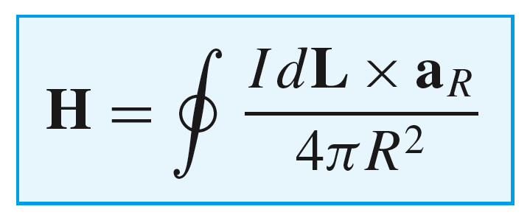
11: The Steady Magnetic Field
Magnetic Field Arising From a Circulating Current
At point P, the magnetic field associated with
the differential current element IdL is
To determine the total field arising from the closed circuit path, we sum the contributions from the current elements that make up the entire loop, or
The contribution to the field at P from any portion of the current will be just the above integral evaluated over just that portion.
4

Slide 6
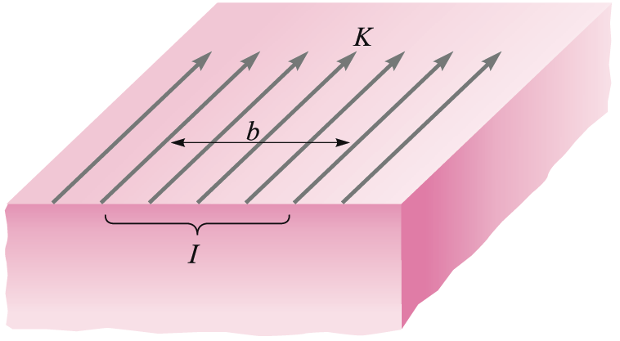
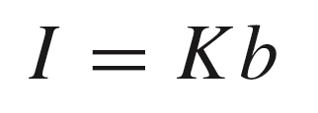
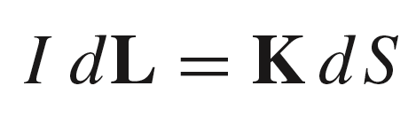
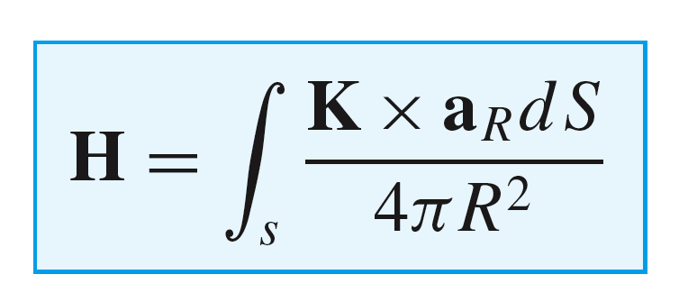
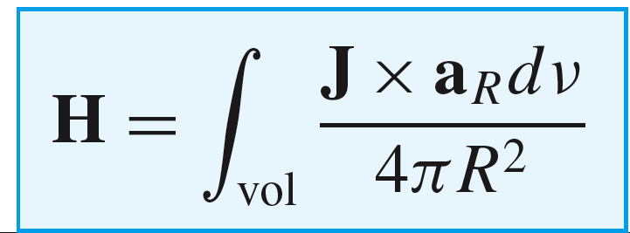
11: The Steady Magnetic Field
Two- and Three-Dimensional Currents
On a surface that carries uniform surface current
density K [A/m], the current within width b is
..and so the differential current quantity that
appears in the Biot-Savart law becomes:
The magnetic field arising from a current
sheet is thus found from the two-dimensional
form of the Biot-Savart law:
In a similar way, a volume current will be made up
of three-dimensional current elements, and so the Biot-Savart law for this case becomes:
5

Slide 7

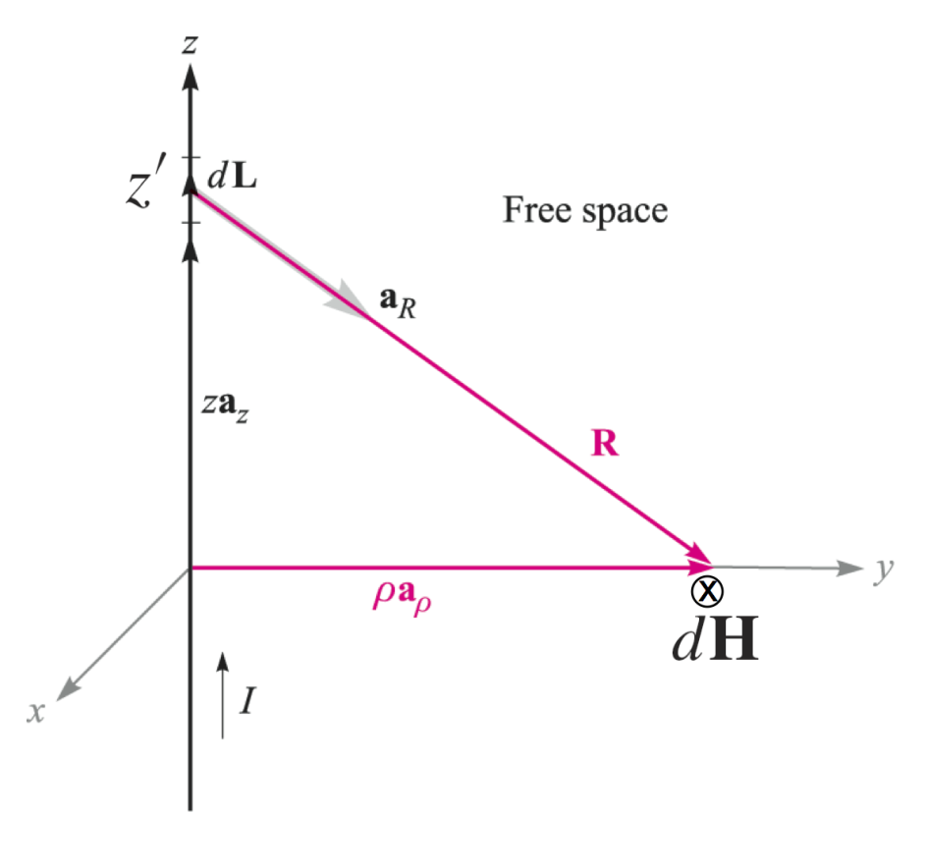
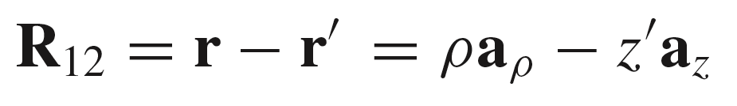

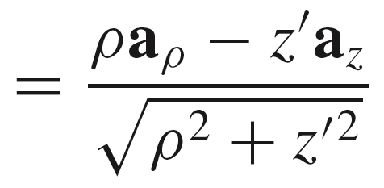

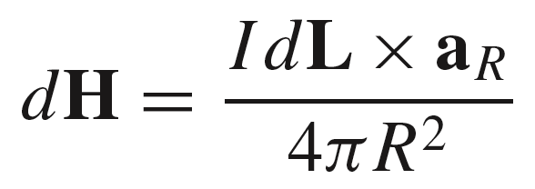
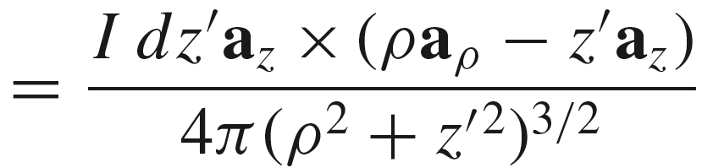
11: The Steady Magnetic Field
Example of the Biot-Savart Law
In this example, we evaluate the magnetic field intensity on the y axis (equivalently in the xy plane) arising from a filament current of infinite length on the z axis.
Using the drawing, we identify:
and so..
so that:
6

Slide 8
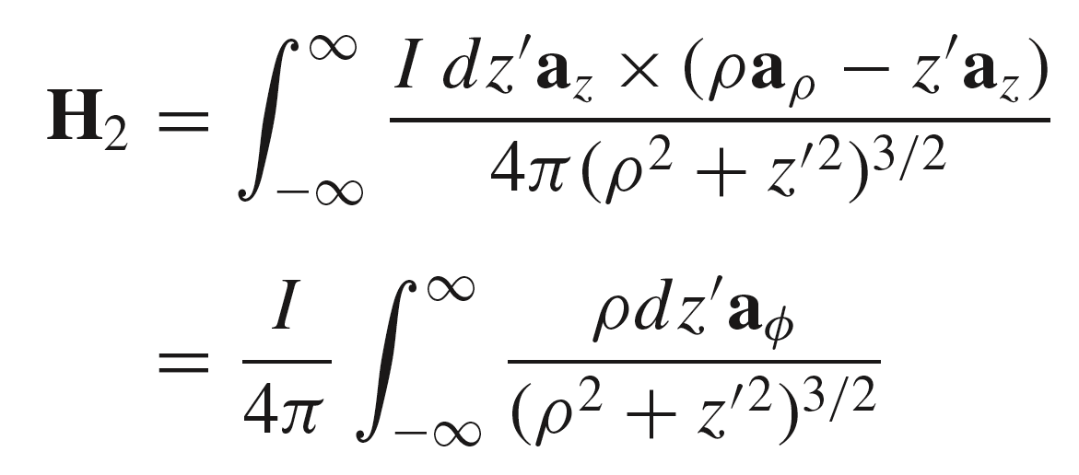

11: The Steady Magnetic Field
Example of the Biot-Savart Law (Cont’d)
We now have:
Integrate this over the entire wire:
..after carrying out the cross product
7

Slide 9
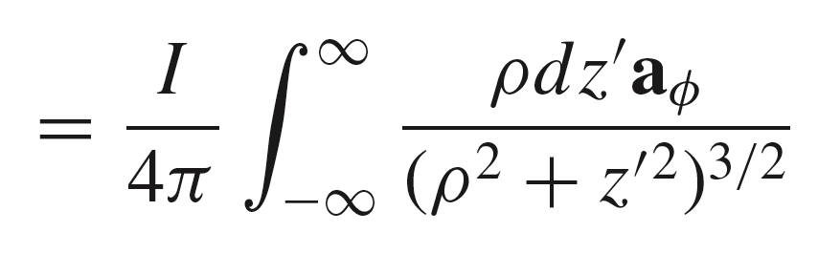
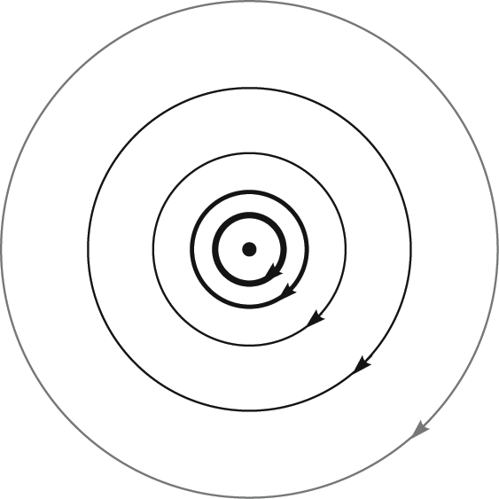

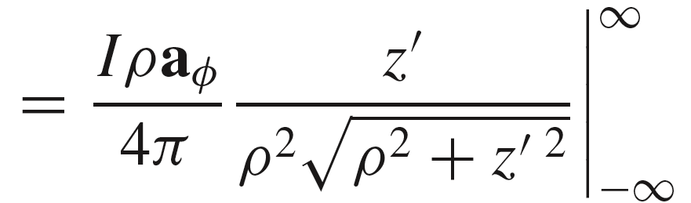
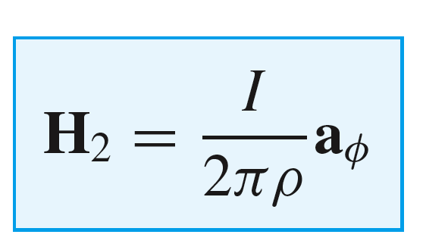
11: The Steady Magnetic Field
Example of the Biot-Savart Law (Cont’d)
we have:
Current is into the page.
Magnetic field streamlines
are concentric circles, whose magnitudes
decrease as the inverse distance from the z axis
finally:
8

Slide 10
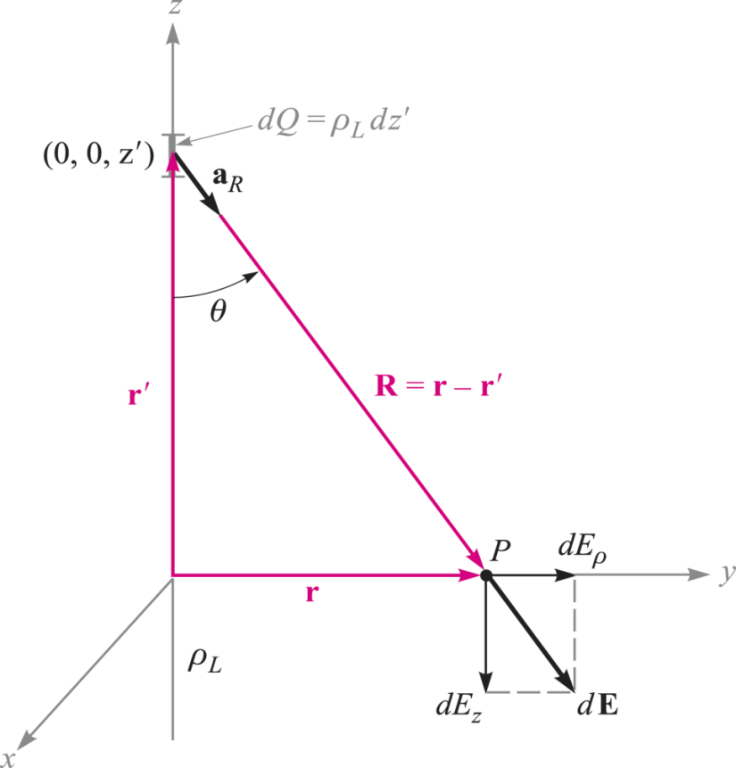
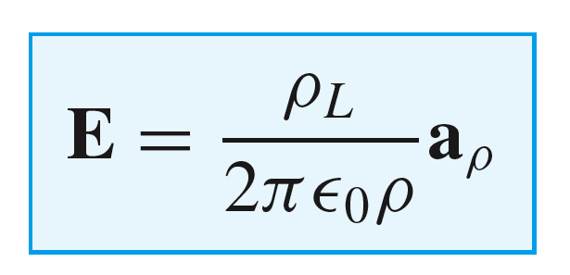
11: The Steady Magnetic Field
Comparison: Electric field of a line charge Vs Magnetic field of a line current
9

Slide 11
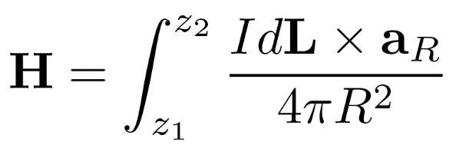
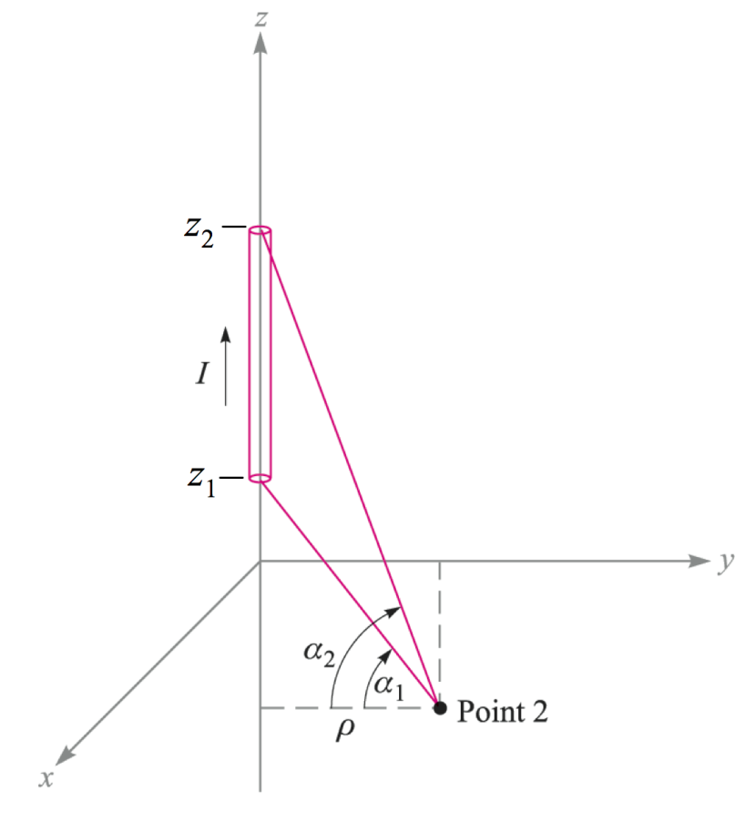
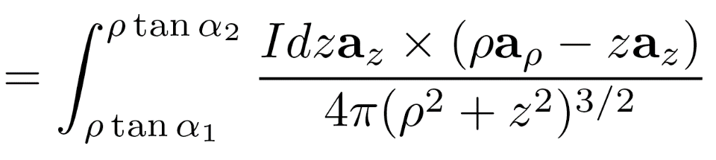
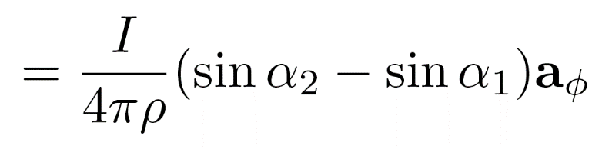

11: The Steady Magnetic Field
Magnetic Field Arising from a Finite Current Segment
In this case, the field is to be found in the xy plane at Point 2. The Biot-Savart integral is taken over the wire length:
..after a few additional steps we find:
10

Slide 12
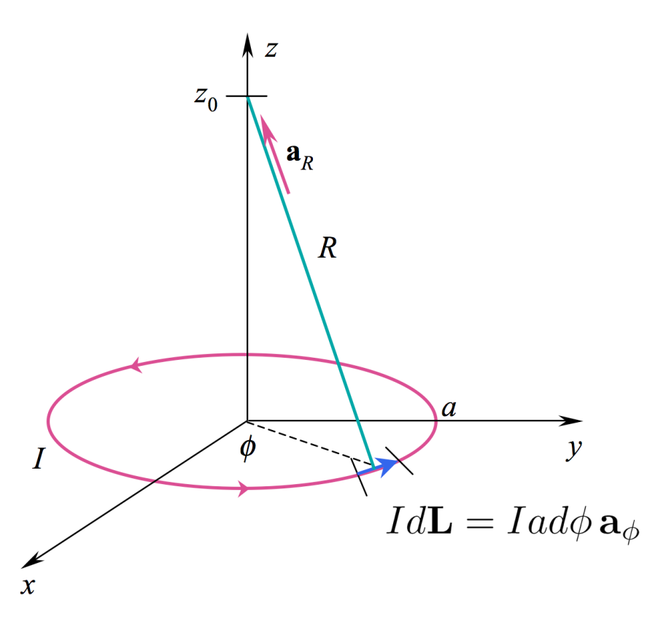
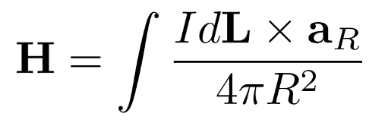

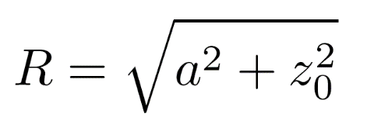
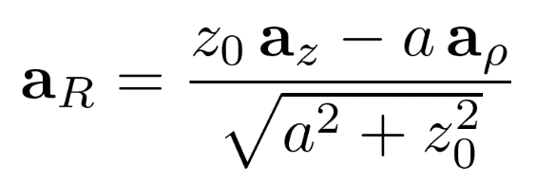
11: The Steady Magnetic Field
Another Example: Magnetic Field from a Current Loop
Consider a circular current loop of radius a in the x-y plane, which
carries steady current I. We wish to find the magnetic field strength
anywhere on the z axis.
We will use the Biot-Savart Law:
where:
11

Slide 13
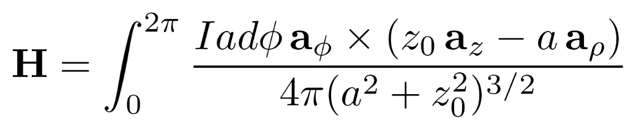
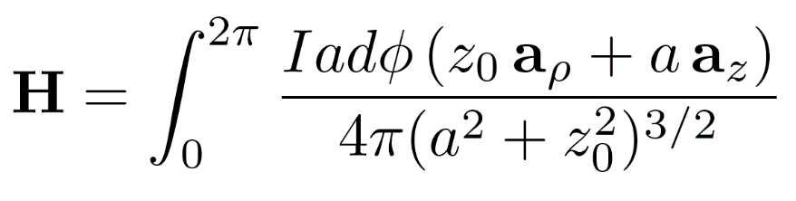
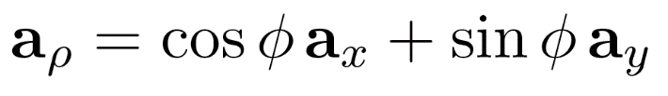
11: The Steady Magnetic Field
Another Example: Magnetic Field from a Current Loop
Substituting the previous expressions, the Biot-Savart Law becomes:
carry out the cross products to find:
but we must include the angle dependence in the radial unit vector:
with this substitution, the radial component will integrate to zero, meaning that all radial components will cancel on the z axis.
12

Slide 14
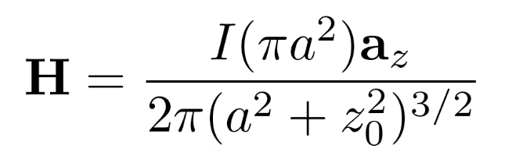
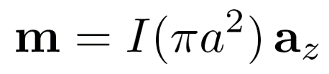
11: The Steady Magnetic Field
Another Example: Magnetic Field from a Current Loop
Now, only the z component remains, and the integral
evaluates easily:
Note the form of the numerator: the product of
the current and the loop area. We define this as
the magnetic moment 磁矩:
Note: Please compare the magnetic moment with the electric dipole moment which both are vectors.
13

Slide 15
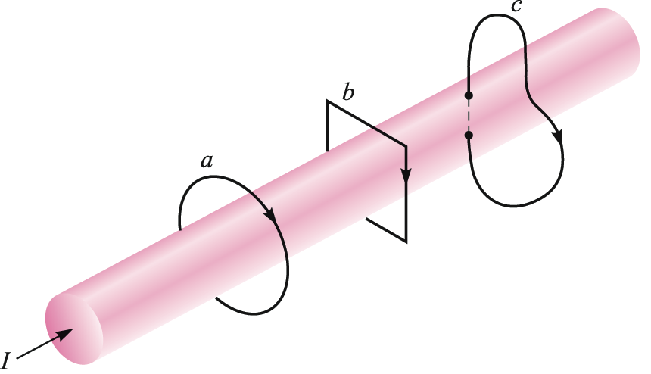
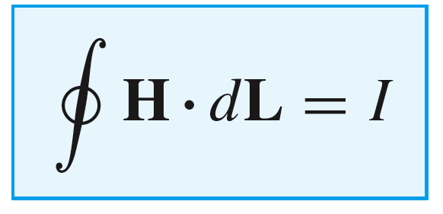
11: The Steady Magnetic Field
Ampere’s Circuital Law 安培环路定律
Ampere’s Circuital Law states that the line integral of H about any closed path is exactly equal to the direct current enclosed by that path.
In the figure at right, the integral of H about closed paths a and b gives the total current I, while the integral over path c gives only that portion of the current that lies within c.
14

Slide 16
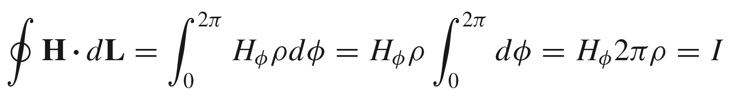
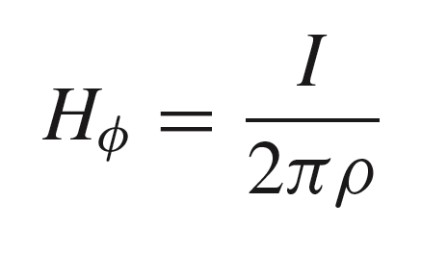
11: The Steady Magnetic Field
Ampere’s Law Applied to a Long Wire
Symmetry suggests that H will be circular, constant-valued at constant radius, and centered on the current (z) axis.
Choosing path a, and integrating H around the circle
of radius ρ gives the enclosed current, I:
ρ
so that:
as before.
15

Slide 17
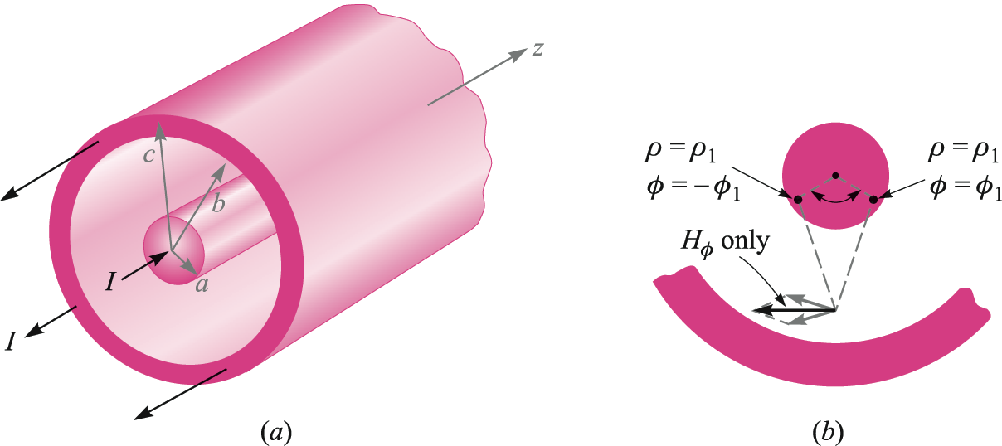
11: The Steady Magnetic Field
Ampere’s Law Applied to Coaxial Transmission Line
In the coax line, we have two concentric
solid conductors that carry equal and opposite
currents, I.
The line is assumed to be infinitely long, and the
circular symmetry suggests that H will be entirely
φ - directed, and will vary only with radius ρ.
Our objective is to find the magnetic field
for all values of ρ .
16

Slide 18
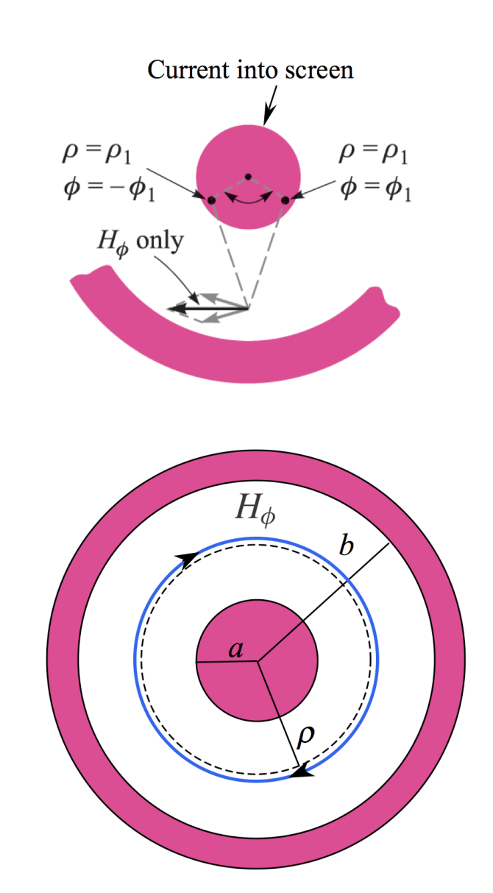
11: The Steady Magnetic Field
Ampere’s Law Applied to Coaxial Transmission Line
Field Between Conductors
The inner conductor can be thought of as made up of a bundle of filament currents, each of which produces the field of a long wire.
Symmetry suggests that H will be circular, constant-valued at constant radius, and centered on the current (z) axis.
Choosing the closed circle in blue with radius as ρ, and integrating H around this circle gives the enclosed current, I:
a < ρ < b
17

Slide 19
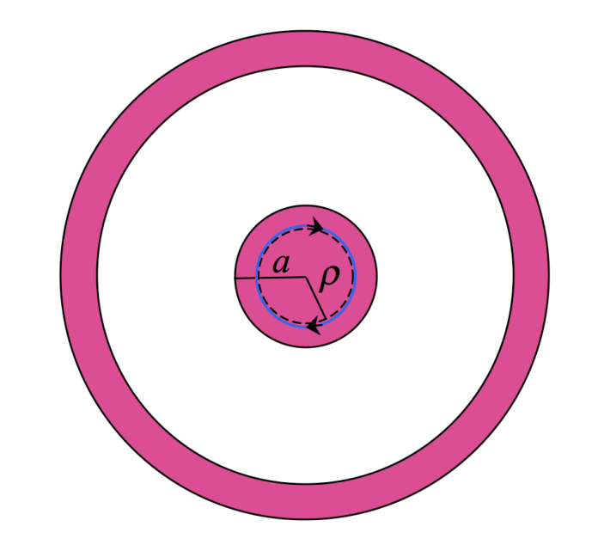
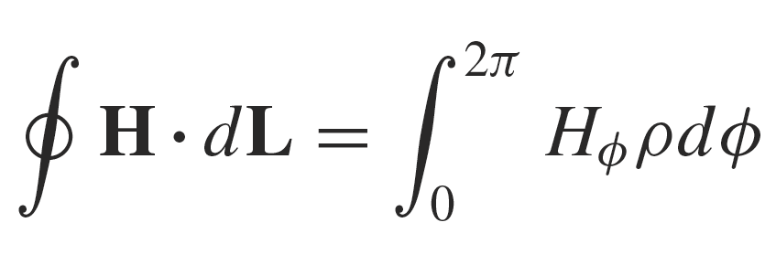
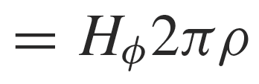
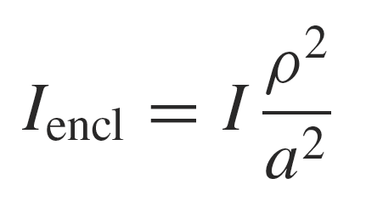


11: The Steady Magnetic Field
Ampere’s Law Applied to Coaxial Transmission Line
Field Within the Inner Conductor
Inside the inner conductor, and at radius ρ, we again have:
But now, the current enclosed is
so that
or finally:
18

Slide 20



11: The Steady Magnetic Field
Ampere’s Law Applied to Coaxial Transmission Line
Field Outside Both Conductors
Outside the transmission line, where ρ> c,
no current is enclosed by the integration path,
and so
0
As the current is uniformly distributed, and since we
have circular symmetry, the field would have to
be constant over the circular integration path, and so it
must be true that:
19

Slide 21



11: The Steady Magnetic Field
Ampere’s Law Applied to Coaxial Transmission Line
Field Inside the Outer Conductor
Inside the outer conductor, the enclosed current consists
of that within the inner conductor plus that portion of the
outer conductor current existing at radii less than ρ
Ampere’s Circuital Law becomes
..and so finally:
20

Slide 22

11: The Steady Magnetic Field
Ampere’s Law Applied to Coaxial Transmission Line
Magnetic Field Strength as a Function of Radius in the Coaxial Transmission Line
21

Slide 23





11: The Steady Magnetic Field
Magnetic Field Arising from a Current Sheet
For a uniform plane current in the y direction, we expect an x-directed H field from symmetry.
Applying Ampere’s circuital law to the path
we find:
or
In other words, the magnetic field is discontinuous across the current sheet by the magnitude of the surface current density.
22

Slide 24






11: The Steady Magnetic Field
Magnetic Field Arising from a Current Sheet
If instead, the upper path is elevated to the line between and , the same current is enclosed and we would have
from which we conclude that
so the field is constant in each region (above and below the current plane)
By symmetry, the field above the sheet must be
the same in magnitude as the field below the sheet. Therefore, we may state that
and
23

Slide 25


11: The Steady Magnetic Field
Magnetic Field Arising from a Current Sheet
The actual field configuration is shown below, in which magnetic field above the current sheet is equal in magnitude, but in the direction opposite to the field below the sheet.
The field in either region is found by the cross product:
where a_{N} is the unit vector that is normal to the
current sheet, and that points into the region in
which the magnetic field is to be evaluated.
24

Slide 26

11: The Steady Magnetic Field
Magnetic Field Arising from Two Current Sheets
Here are two parallel currents, equal and opposite, as you would find in a parallel-plate
transmission line. If the sheets are much wider than their spacing, then the magnetic field
will be contained in the region between plates, and will be nearly zero outside.
H_{x2} (z > d/2 )
These fields cancel for current sheets of infinite width.
H_{x1} (z > d/2 )
K₁ = -K_{y} a_{y}
These fields are equal and add to give
H_{x1} (-d/2 < z < d/2 )
H_{x2} (-d/2 < z < d/2 )
H = K x a_{N} (-d/2 < z < d/2 )
K₂ = -K_{y} a_{y}
where K is either K₁ or K₂
H_{x1} (z < -d/2 )
These fields cancel for current sheets of infinite width.
H_{x2} (z < -d/2 )
25

Slide 27




11: The Steady Magnetic Field
Magnetic Field Arising from Current Loop Field
Using the Biot-Savart Law, we previously found the magnetic
field on the z axis from a circular current loop:
We will now use this result as a building block
to construct the magnetic field on the axis of
a solenoid 螺线管 -- formed by a stack of identical current loops, centered on the z axis.
26

Slide 28




11: The Steady Magnetic Field
On-Axis Field Within a Solenoid
We consider the single current loop field as a differential contribution to the total field from a stack of N closely-spaced loops, each of which carries current I. The length of the stack (solenoid) is d, so therefore the density of turns匝数will be N/d.
z
d/2
Now the current in the turns within a differential length, dz, will be
We consider this as our differential “loop current”
-d/2
so that the previous result for H from a single loop:
now becomes:
in which z is measured from the center of the coil,
where we wish to evaluate the field.
27

Slide 29



11: The Steady Magnetic Field
On-Axis Field Within a Solenoid
The total field on the z axis at z = 0 will be the sum of the field contributions from all turns in the coil -- or the integral
of dH over the length of the solenoid.
z
d/2
-d/2
28

Slide 30




11: The Steady Magnetic Field
On-Axis Field Within a Solenoid
We now have the on-axis field at the solenoid midpoint (z = 0):
z
d/2
Note that for long solenoids, for which , the
result simplifies to:
-d/2
This result is valid at all on-axis positions deep within long coils -- at distances from each end of several radii.
29

Slide 31



11: The Steady Magnetic Field
On-Axis Field Within a Solenoid: Continuous Surface Current
d/2
Therefore:
-d/2
30

Slide 32

11: The Steady Magnetic Field
Solenoid Field -- Off-Axis
To find the field within a solenoid, but off the z axis, we apply Ampere’s Circuital Law in the following way:
The illustration below shows the solenoid cross-section, from a lengthwise cut through the z axis. Current in the windings flows in and out of the screen in the circular current path. Each turn carries current I. The magnetic field along the z axis is NI/d as we found earlier.
32

Slide 33


11: The Steady Magnetic Field
Solenoid Field -- Off-Axis
Applying Ampere’s Law to the rectangular path shown below leads to the following:
33

Slide 34

11: The Steady Magnetic Field
Solenoid Field -- Off-Axis
The radial integrals will now cancel, because they are oppositely-directed, and because in the long coil, is not expected to differ between the two radial path segments.
34

Slide 35

11: The Steady Magnetic Field
Solenoid Field -- Off-Axis
What is left now are the two z integrations, the first of which we can evaluate as shown. Since this first integral result is equal to the enclosed current, it must follow that the second integral -- and the outside magnetic field -- are zero.
35

Slide 36

11: The Steady Magnetic Field
Solenoid Field -- Off-Axis
The situation does not change if the lower z-directed path is raised above the z axis. The vertical paths still cancel, and the outside field is still zero. The field along the path A to B is therefore NI/d as before.
Conclusion: The magnetic field within a long solenoid is approximately constant throughout the coil cross-section, and is H_{z} = NI/d.
36

Slide 37


11: The Steady Magnetic Field
Toroid Magnetic Field
A toroid is a doughnut-shaped set of windings around a core material. The cross-section could be circular (as shown here, with radius a) or any other shape.
Below, a slice of the toroid is shown, with current emerging from the screen around the inner periphery (in the positive z direction). The windings are modeled as N individual current loops, each of which carries current I.
37

Slide 38






11: The Steady Magnetic Field
Ampere’s Law as Applied to a Toroid
Ampere’s Circuital Law can be applied to a toroid by taking a closed loop integral around the circular contour C at radius ρ. Magnetic field H is presumed to be circular, and a function of radius only at locations within the toroid that are not too close to the individual windings. Under this condition, we would assume:
This approximation improves as the density of turns gets higher
(using more turns with finer wire).
Ampere’s Law now takes the form:
so that….
Performing the same integrals over contours drawn in the
regions or will lead to zero magnetic field there, because no current is enclosed in either case.
38

Slide 39




11: The Steady Magnetic Field
Surface Current Model of a Toroid
Consider a sheet current molded into a doughnut shape, as shown. The current density at radius crosses the xy plane in the z direction and is given in magnitude by K_{a}
Ampere’s Law applied to a circular contour C inside the
toroid (as in the previous example) will take the form:
leading to…
inside the toroid…. and the field is zero outside as before.
39

